Slide 1
Zoom Annotations
Step 1
Step 2
Step 3
Step 4

Slide 2
Zoom Annotations - iPad
Step 1
Step 2

Slide 3
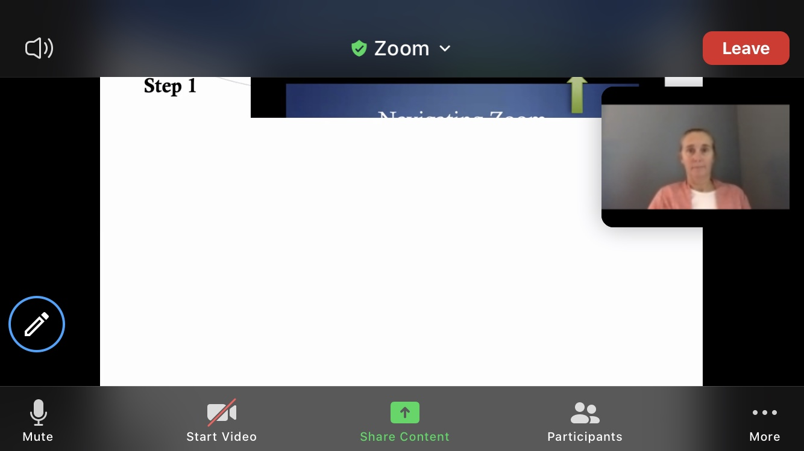
Zoom Annotations - Phone
Step 1
Step 2

Slide 4
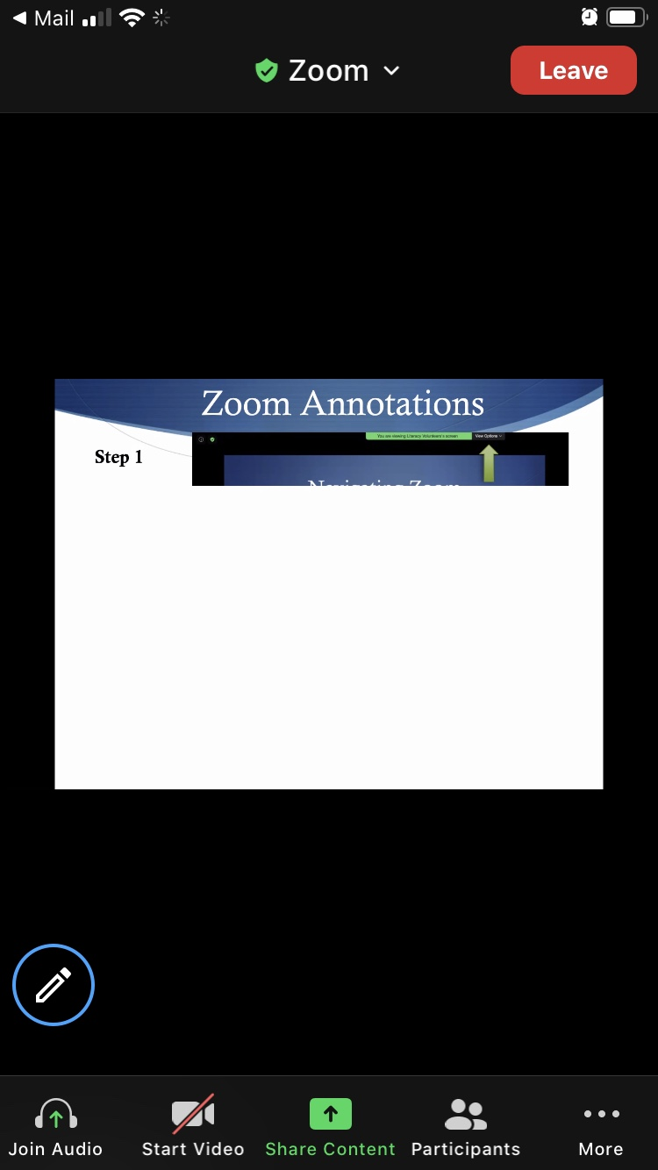
Zoom on a Phone
Turn Phone Sideways

Slide 5
Zoom on a Phone
Use at least 24 point font on your slides or documents
Top right corner of slide or document will be blocked by video screen showing the tutor

Slide 6
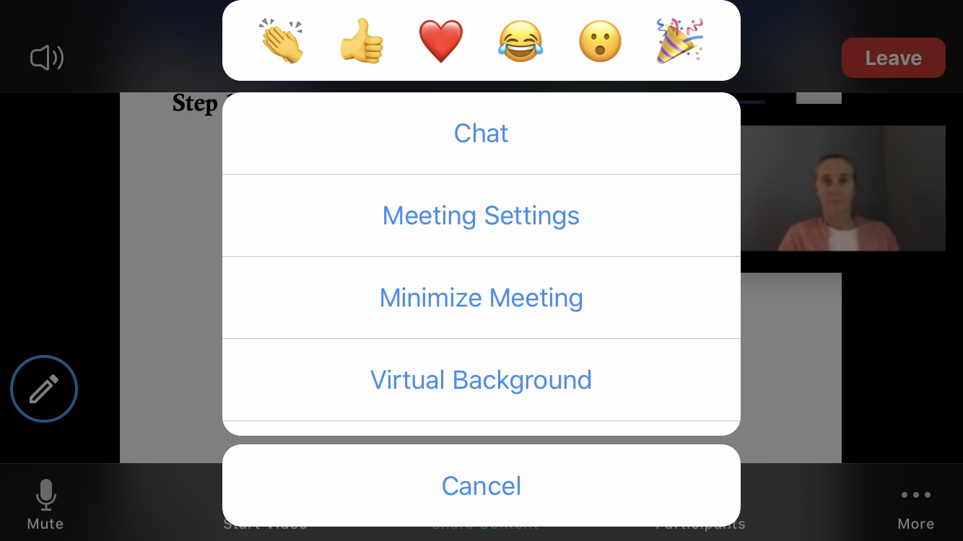
Zoom on a Phone: Accessing Chat & Reactions
Step 1
Step 2

Slide 7
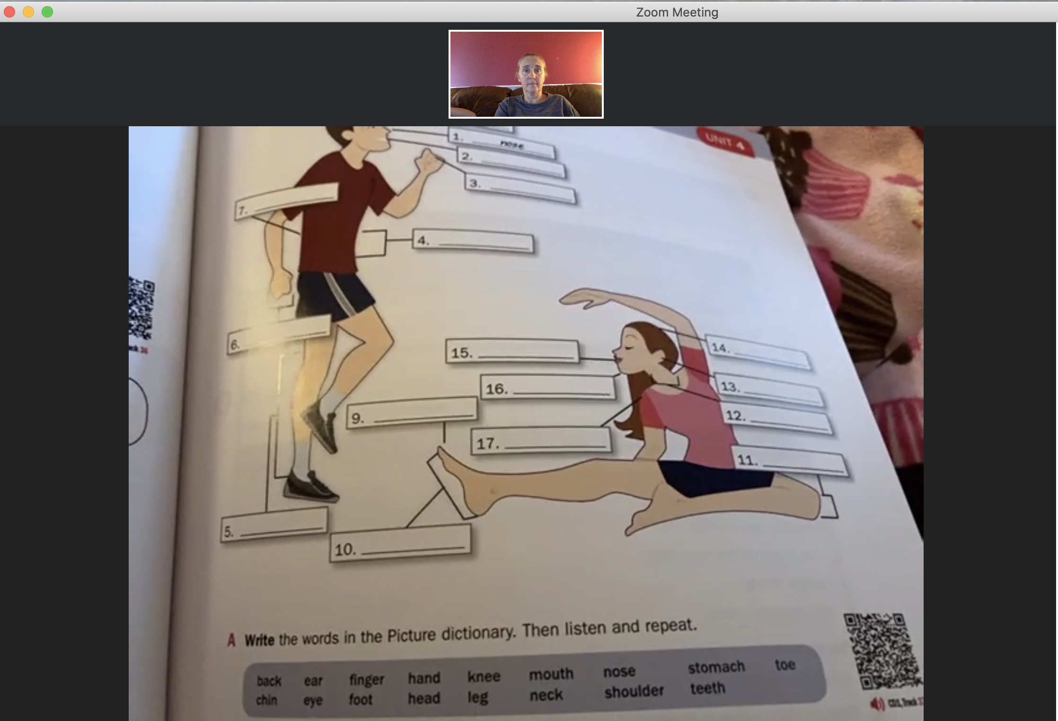
Zoom on a Phone: Using Rear-Facing Camera
Step 1
Student
Step 2
Student’s View
on their Phone
Tutor View
on a Computer

